Slide 1
Diversity of Appearance
By: Sally-Ann Cudjoe & Patrick Teshima

Slide 2

What We Didn’t Know
How in depth and interconnected diversity of appearance is in relation to other forms of discriminations
Most companies don’t actively pursue inclusion
In 2014, the Army published new appearance regulations banning most natural hairstyles of Black women
Title VII nor the ADA cover employment discrimination because of height
So many different law suits & cases because of discrimination of appearance
That Looks-Based-Hiring or Lookism style of hiring is legal and used by many companies
That most states do not protect their employees from appearance based discrimination
There is a growing number of advocacy groups to combat discrimination in the workplace

Slide 3

What Shouldn’t Be Missed
No US Federal law specifically offers employment protection based on appearance. However, Title VII, the Americans with Disabilities Act (ADA) and the Age Discrimination in Employment Act (ADEA) are possibilities for use to prosecute discriminating employers, based on the facts of the case
Appearance matters in our society today more than it ever has before
Diversity of appearance is determined by norms and expectations set by the dominant members of society
The rights of employers and the rights of employees
There is a growing number of services to help promote more inclusive work environments such as Paradigm

Slide 4
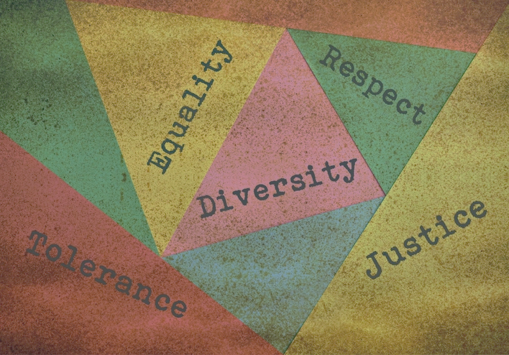
Section I
SOCIAL INJUSTICE ISSUES

Slide 5
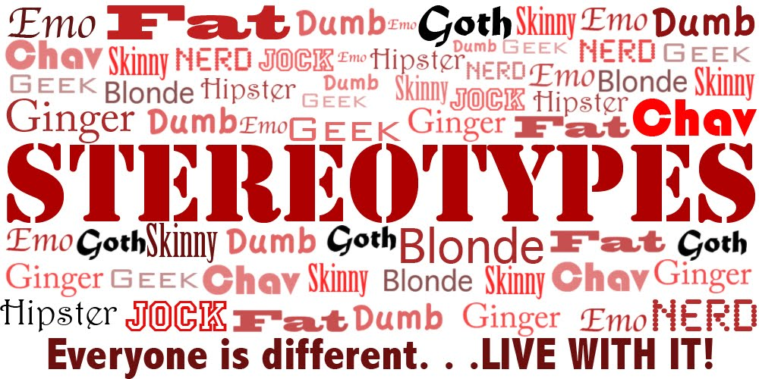
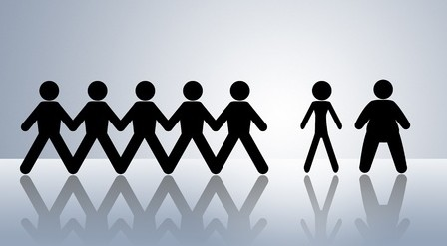
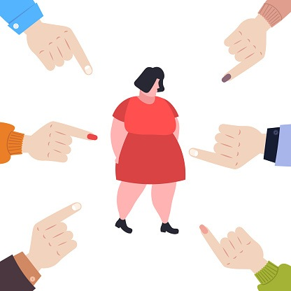
Societal Stereotypes
The Looks Policy in collaboration with “Beauty is good”
Obese people are obese because they eat too much, lack exercise, and are less productive workers
Short men are more aggressive than taller men
Males are typically perceived as more attractive when they have more stereotypically “masculine” characteristics
People with disability are unintelligent and needy
Notes:
“The Looks Policy in collaboration with Beauty is good” - stereotype refers to the assumption that physically attractive people possess a more socially desirable personality and higher moral standards. Believe it or not, it is also assumed by many employers that beauty on the outside is directly related to one’s intellectual capacity. They tend to get higher salaries, better performance evaluations, higher levels of admission to college, better voter ratings when running for public office and more favorable judgments in trials.
“Obese people are obese because they eat too much, lack exercise, and are less productive workers” - this long time and fastly rising myth continues to give way to ignorance and the justification by many employers and employees alike to mistreat and discriminate against fuller figured people, masking it under what is termed weightism.
“Short men are more aggressive than taller men” - this is the notion that a shorter man has always to be on the defensive side because of his height.It is believed that shorter men have an inferiority complex because of his height and so they are more likely to pick fights because they have more to prove. This complex has been termed the Napoleon Complex (Henderson 2108).
“People with disability are unintelligent and needy” - many individuals who are deemed disabled by means of birth, incidents or accidents are looked down upon as meaningless, useless, needy and unintelligent. These uneducated and presumptuous conclusions have led to many disabled people not receiving a fair chance to excel and to utilize their true ability. And if they are honored to receive such a “privileged” opportunity to acquire a job, they are further insulted because of the types of jobs of which they are given the responsibility.

Slide 6
Exclusion, Discrimination, and Inequalities
More than 1 in 4 employees have experienced discrimination because of their looks. Most often it happens to be women
More than one-third of U.S. workers report experiencing or witnessing religious biases at work
Hiring decisions are often times based on looks.
Employers use the “halo effect” to make judgement calls
Appearance based discrimination is usually a spill-off effect from one of the other forms of discriminatory elements such as; race, age, sex, religion ect.
Gender pay gaps
in 2019 a woman working a full-time, year-round job earned about 79% as much as her male counterpart earns or .79 cents to the dollar
in 2020, there has been a reported increase to about 81% as much as her male counterpart earns or .81 cents to the dollar
Notes:
Research has shown that discrimination comes in many different forms and experiences for different classes of people. For instance, evidence has been provided which shows 25% of employees are discriminated against or have seen their colleagues being discriminated against due to their perceived and visible differences (Schwantes 2019). Often times these occurrences are geared towards females within the workplaces because they are seen as the weaker vessel and an easier push-over. Additionally, one-third have reported either being discriminated against or witness their colleague being taken advantage of because of their religious preference.
Employers are continually abusing their power to exploit and discriminate against applicants during hiring processes based on their outward appearance and not their ability or intelligence (Cavico et al 2013). Instead they are making judgement calls based on “halo effect”, or in other words, an applicant or an existing employee for that matter is judged by an employer based on one positive preconceived thought to govern his or her entire existence. Also often times, employers chose to use elements such as age, sexual orientation, religion and so on to based conclusive and impactful decisions.
Employees or potential employees who do not confirm to the accepted norms of the dominant groups are usually treated differently than those who are.These differences in norms may vary in relation to one’s age, sex, his/her religion, sexual orientation or race among others.Unfortunately for some people they may be intersectional making his or her chances of acceptance even further away from a reality. Another form of discrimination comes within the realms of gender pay gaps. Though statistics have shown a widespread difference such as race, ethnicity ect. The most prominent of the differences falls between that of a male versus a female. Females are known to receive marginally lower wages than do males irrespective of race, ethnicity or else. As the snippet above shows, in 2019 a woman received 79 cents to the dollar of a man in the same year for the same job and 81 cents in 2020 (https://www.payscale.com/data/gender-pay-gap).

Slide 7
Example: Lewis v. Heartland Inns of America
Lewis worked at Heartland Inn as a night Auditor
Started as a part-time worker and was offered a full-time position, approved by the Director of Operations based on recommendation from Lewis’ Manager on the basis of good performance (no interviews)
Lewis wore short hair and loose fitting clothing
Lewis was subsequently fired by the Director of Operations
Lewis sued for violation of Title VII, sex discrimination
Heartland countersued for “thwarting” the interview procedure and exhibiting “hostility” to Heartland's policies
The trial judge dismissed the case.
Lewis appealed.
In January 2010, a three judge panel ruled in Lewis' favor
Notes:
Though Lewis was successful in the outcome of her case against her former employer, Heartland Inns of America, the fight for human rights are far from over. Unfortunately, some states still do not have a law which governs the stereotypical discrimination of employees by their employers based on their physical appearance and thus, it is very easy for employers to be able to terminate an employee solely on the basis of his/her’s appearance.
There is yet the life’s lesson to be learned which highlights that it should not matter whether or not a stereotypical discriminatory termination is the result of a particular supervisor’s preference or a company-wide appearance policy, it is WRONG.
Amendments should be made to Title VII Civil Rights Act to include prohibition of physical appearance discrimination in ALL states.
Instructor Note: Clarification: Lewis was not just dressing in “loose fitting clothing” but in what might be considered a more stereotypical masculine look: men’s button down shirts, slacks, short hair, no makeup. Her director stated front desk women staff members should be “pretty” and have a “Midwestern girl look.” This is why she was able to successfully sue based on sex discrimination.

Slide 8

Section II
Legal Protections and Allies

Slide 9
Laws & Accepted Policies
Title Vll of the Civil Rights Act offers some protections and prohibits discrimination by employers, labor organizations, and employment agencies on the basis of race, color, sex, religion, and national origin.
Equal Pay Act of 1963, which protects men and women from sex-based wage discrimination
Title I and Title V of Americans with disabilities act of 1990, which protects employees from being discriminated on the basis of disabilities. This also affects state and local governments as well.
The Civil Rights Act of 1991.
Provides financial back pay to victims of discrimination
Notes:
The laws such as the ADEA affect businesses who hire 20 or more employees and covers school districts, local and state governments, and other organizations of labor.
Like the Age Discrimination in employment Act (ADEA) it is not illegal for an employer to choose an older worker over a younger looking person even if both people are over the age of 40. As stated above appearance is socially constructed with norms and expectations such as men should have short hair and be taller while women should wear makeup and have longer hair. Some cultures that are not part of the dominant one will have disadvantages when it comes to finding a job as they look different from the dominant culture. Some people will have complexions that naturally look older or younger than what a business may “deem” acceptable in their eyes. As many other laws have been past to address other issues there has not been a formal law past to account for how one looks such as if a person is overweight or is considered not good looking.
Equal Pay Act protects employees from their wages being affected based on sex if they have similar skill, responsibility, and work for the same employer under work conditions that are similar
The Civil Rights Act of 1991 is a continuation of Title Vll which protects against discrimination. The act added on remedies to help those who were discriminated against at work.

Slide 10
State Laws
Michigan
prohibits state employers from discriminating against employees based on sexual orientation and/ or gender identity or expression.
New York
Prohibits the discrimination of people who wear their hair naturally which is under the Human Rights Act for the city.
California
Crown Act, this act protects employees from discrimination who wear their hair in its natural was such as the Afro-Textured curly hair seen in African Americans or other hair styles.
Illinois
In 2005 a statute was passed protecting employees from sexual orientation as well as other discrimination protections.
Notes:
In 2003 and 2007 two executive orders were past in Michigan to protect employees from discrimination such as religion, race, color, national origin, age, sex, sexual orientation, gender identity or expression, height, weight, marital status, partisan considerations, or a disability or genetic information that is unrelated to the person’s ability to perform the duties of a particular job or position.
So far Michigan is the only state to have protections against appearance based discrimination. Massachusetts has a current bill in the senate, Bill S.2495, that will protect employees from discrimination based on height and weight as well as other protections. In the matter of appearance, most states do not have laws that protect employees that are discriminated against for how they look.
In 2019 California and New York had laws that were passed to protect employees who were their hair in a natural style. In california, under the Fair Employment and Housing Act (FEHA), the Crown Act will include traits that are historically associated with the specific race which would include hair texture as well as other traits.

Slide 11


Advocacy Groups
STRIPED (strategic training initiative for the prevention of eating disorders)
This group has actively pushed for laws that would protect employees from being discriminated against for their height and weight.
Human Rights Campaign Foundation
Provides protections based on sexual orientation and gender identity which includes how they dress in the workplace.
They also include policies such as inclusive healthcare to transgender people.
Notes:
STRIPED started in 2009. focuses on size discrimination such as obesity and pushes for legislation for companies to protect against discrimination.
The group STRIPED has helped push a bill in the senate, bill S.2495, that would prevent against discrimination based on height and weight.
It continues to push for human resources strategies in the workplace
The Human Rights Campaign has worked with educating companies and organizations with groups of people who may appear different in appearance and behavior for example members of the LGBTQ and those of color who identify as LGBTQ.
In the workplace they have helped companies make non-discrimination policies
They have bolstered education on the LGBTQ community so disscustions can happen.
These 2 advocacy groups facilitates with educating people on how to recognize others true value and potential irrespective to who they perceive them to be, as it is vital that no one be taken for granted because one may never know another’s source of knowledge or capability. Or in other words, as the old saying goes “never judge a book by its cover”.

Slide 12
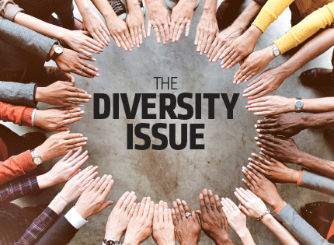
Section III
In Today’s Workplace

Slide 13
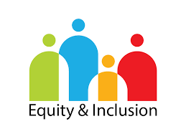
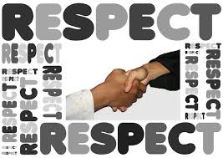
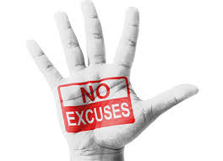
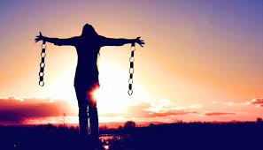
What Do Employees Desire and Need?
Equity & inclusivity
Respect
Accountability
Freedom
Notes:
Equity & Inclusivity - members of this dimension who do not confirm with the physical attributes which qualifies him or her to be deemed attractive would like for the playing field to be more level. Jobs, promotions and other professional opportunities should be more equally distributed and readily available to people of all stature based on qualification and ability to perform, NOT by looks only. Also, for amendments to be made to Federal and State Laws to reflect protection from discrimination. And finally, to be included as an honorable and appreciated member of the organization, to be seen and heard.
Respect - to be treated with respect and dignity, honoring their cultural, religious and physical existence and beliefs. To be counted for what’s on the inside rather than judged from what’s seen on the outside.
Accountability - for employers to be held accountable when they stray away from their corporate social responsibilities of providing a safe and healthy working environment to all of their workers
Freedom - to be their true self without fear of ridicule, victimization, and retaliation if they choose to exercise their rights to speak out against the discriminatory acts they may encounter

Slide 14


Institutional and/or Interpersonal Opportunities for Equity and Inclusion

Slide 15
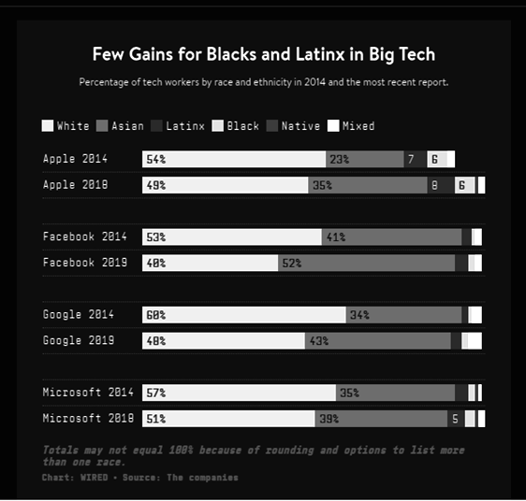
Institutions Equality and Inclusion
Many institutions are still occupied by the majority culture, mainly being white and male
When it comes to hiring practices many of the business leaders hire people who are like them.
This leads to a less diverse work environment and may lead to an imbalance of needed diversity.
Most of the makeup of larger companies are still predominantly white and mostly men .
Notes:
In the 2010’s silicon valley, which is located in northern california and harbors the major companies that we see everyday, started to release their demographic data to the general public after pressure started to surface about the diversity in businesses. As the image shows from the time these big companies started releasing data about their demographics, not much has changed expect for the greater number of Asians who are now in these companies. For the remaining minorities such as Latinos and African Americans, there is still a large deficit of how many are in these areas. So far there is not a lot of diversity even in the largest of companies and therefore the chance for more of an inclusive work still remains small.

Slide 16
Starting the Change for Institutions
There are a lot of resources to help companies to become better at inclusion such as Paradigm.
This support service helps companies create safe environments for all types of employees to work, thereby creating an inclusive environment.
Institutions and human resource persons can help to create policies to include all type of backgrounds such as, not restricting how employees dress their hair.
Companies can encourage volunteering which can be an effective way to meet other people from different backgrounds within the work environment.
This can create greater understanding between employees and how they feel.
For companies, volunteering is a relatively cheap way to connect employees with themselves and employers who may otherwise not see eachother out side of the work environment.
Notes:
Paradigm is a service that helps companies understand what is inclusion and how there are barriers that prevent it such as biases that are held. One has an option of either in person and/or online seminars of which help employees and employers face the truth about themselves. In these seminars, employers go through the process of how to make an inclusive hiring, how to make an inclusive environment in the face of the Corona virus and much more. Employers can sign up their companies for the webinars and so far it has been proven to be extremely effective to the extent that Paradigm has won a 2019 award for best places to work, as they have created their work environment to effectively include the people with whom they work. If a company does not have the resources to sign up for services such as Paradigm, there are other ways institutions can start making a workplace inclusive. Employers can also use websites that can be used to understand their unconscious biases such as Mindtools.com to help them to better understand themselves.
Company based volunteering can make a great to increase the understanding between employees and the community in which it is helping. Studies on volunteering have shown to increase mental health as well as physical health as well as a chance to meet others from different backgrounds which can help people to talk about their differences. Studies have shown the negative psychological effects of perceived discrimination. The ways to mitigate the negative effects are to have a support group in which volunteering can help with by creating communication between people.

Slide 17

Interesting Issue About Diversity of Appearance
Section IV

Slide 18
Sub-topic: Discrimination Against African American
Physically attractive people are given more credit than they sometimes deserve because of their outward beauty. This extra credit is considered the “halo effect”. Unfortunately for Blacks they are neither considered attractive nor are most given the credit they deserve
African Americans face methodological obstacles to getting good jobs
Fewer job opportunities
Higher unemployment rates
white unemployment rate fell 2.3 percentage points to 10.1% from 12.4%, while the rate for Blacks dropped 1.4 points to 15.4% from 16.8%
Many African Americans face what’s called “occupational segregation” - where usually, Black workers end up in lower paid jobs than White workers
Up until October, 2019 African Americans were not allowed to embrace the beauty of their natural hair
Myths:
black hair in its natural state is dirty and unkept
locks or braids signals that the wearer is not interested in “fitting in”
Notes:
African Americans face many general challenges in life, but moreso, methodological obstacles when attempting to land a good job. This has led to members of this group to enjoy fewer good job opportunities and also be a count towards the ratio of higher unemployment rates.
Many may debate the fact of whether or not it is true that African Americans receive less opportunities than do Whites in getting a job, and that is understandable and to some extent very true. However, the real debate is the quality of jobs Blacks are provided irrespective to held qualifications and capabilities. In other words, Blacks face much more occupational segregation than do Whites which ultimately results in lower paid jobs also.
The Crown Act became the voice of reckoning for African Americans first in the state of California, prohibiting schools and businesses from discriminating against African Americans and their wearing of their natural hair in a non-conforming European style, which includes cornrows, Afros or dreadlocks (Jeff et al 2020).The Crown Act will also help to alleviate the myths surrounding African Americans natural hair as those who were once guilty of those discriminatory notions would now come to realize that like them, African Americans hair is part of what makes them who they are.

Slide 19
Discrimination Against African Americans (cont’d)
Black consumers spent $473 million on hair care in 2017.
Many African Americans (particularly women) say they've felt pressured for decades to use excessive heat, chemical relaxers, weaves, and different grooming techniques to conform to standards of acceptable hair
African Americans are also disproportionately affected by the novel Coronavirus
Since many have lower job opportunities and the jobs they receive are in service jobs, they are naturally more likely to contract the virus.
Only around 44% of African Americans own a home as most live in apartments with other relatives which makes it harder to social distance
African Americans are placed or accepted in lower quality schools than their counterparts
Police brutality because of:
race stereotypes
breaches in the Fourth Amendment Doctrine
vulnerability
Notes:
Black people are constantly under pressure to stray away from their natural being, existence, and lifestyle to adhere to the ways of others especially of the dominant groups (Whites). This includes using excessive head-to-toe measures as; using chemical relaxers, weaves, cutting their dreads, facial hair ect. This has actually lend a hand to causing additional financial strains for many African Americans due to unnecessary and unwanted expense, spent towards grooming care in the name of being a bit more tolerated, $473 million in year 2017 to be more precise (Ellis & Jones 2019). The next discriminatory setback for African Americans is in relation to their schooling. Unfortunately for Blacks, for those whose life’s circumstances afford them the opportunity to attend various educational institutions; many are placed or accepted in schools and universities of lower quality than their White counterparts. Evidentially, this inequality has quite a significant impact since we operate in such a competitive era and the job market opportunities are so limited. Hence, it’s imperative that one’s accolades be among the best in order to make yourself more marketable.
As if it’s not enough that African Americans already have to deal with unfair treatment from the general public, they are also faced with discriminatory offenses from the very ones they look to for security and safety. At late, we have seen what has been predicate to conversations or debates about police violence against Blacks (Breanna Taylor, George Floyd among many others). The issue of racial stereotypes has given way to making this violence against Blacks an easier one. An individual who is Black is often times concluded to be of a violent or criminally inclined nature and thus, is treated off the bat as such. Additionally, there are breaches in the Fourth Amendment which is by law suppose to provide protection for African Americans from unreasonable searches and seizures. However, instead of protection, police is exercising their rights under the doctrine to enable ongoing contact between themselves and African Americans (Carbado & Rock). Furthermore, because of members of this affected group’s skin color, they are viewed as more vulnerable and are therefore more likely to attract police brutality because, they are likewise more likely to be doubted about the case concerning being mistreated and targeted by police officers.
According to the US census data from January 2020, only 44 % of African Americans own a home compared to the 74% of white people who own homes, and thus this makes them more susceptible to illnesses and diseases (CoronaVirus being the latest on the horizon). (census.gov)

Slide 20

Thoughts in Relation to the Topic
Unacceptability directed towards African Americans goes to such extreme that even his or her hair has been a hindrance for so long (up until October of 2019) where it was made illegal to discriminate on that basis
Police brutality against Blacks need to stop
There ought to be a more equitable system which governs activities such as, hiring, firing, and payments for similar jobs
It is not right for someone to be discriminated against because of their race
Members from the African American community should be free to be him or herself which should include, the ability to express self through the wearing of their beautiful natural, traditional and cultural attire (which may be because of religious reasoning), the freedom to report ill manner treatment without fear of retaliation and unnecessary doubting
Notes:
It’s unfathomable how for so many years of similar, repeated offenses by police officers against African Americans, the number of officers indicted and eventually convicted is so low. For example, between 2005 and 2020, of the 42 nonfederal police officers convicted following their arrest for murder due to an on-duty shooting, only five ended up being convicted of murder. The most common offense these officers were convicted of was the lesser charge of manslaughter, with 11 convictions (https://www.statista.com/statistics/1123386/convictions-police-officers-arrested-murder-charge-us/).
Like many other members of different groups (dominant or other non-dominant) African Americans have consistently been down-played as uneducated and criminally inclined solely based on their race, which ultimately leads to many forms of discriminatory acts been held against them. For example, in the absence of a system which provides a level playing field with respect to hiring, firing, and equal pay; employees are continually being exploited against without any serious repercussions to the ones committing these exploits. These exploits are not only hazardous to the recipients of the ill treatments, but employers must also consider that the ripple effect can also be damaging to their own businesses because, they risk losing some potentially great workers which would be able to add value to their organization’s progress.
The racial disparity of African Americans continue to loom over the US and likewise in the 1990’s as Rodney King made headlines and the disparity continues today. Many African Americans are still disproportionately at a disadvantage when it comes to healthcare, education, and employment. All of these lead to a cycle that is very hard to break such as if African Americans cannot find good jobs they will try and save by living together in apartments and taking multiple jobs. This often times leads to increased stress, especially if African Americans decide to exercise their freedom to have children, because this could probably lead to more health issues. With the possibility of more health issues comes the possibility that they will likely have to spend more money on healthcare, which affects how disposable income they may have remaining. And as was referred in a previous slide, the domino effect most likely would follow this trail: inability to afford college attendance, which means lack of higher education, which leads to less income on average. This places them in a cycle that is hard to break as they need finances to keep the apartment or place to live in.

Slide 21
Bibliography

Slide 22
General websites used:
https://malegislature.gov/Bills/191/S2495
https://www.payscale.com/data/gender-pay-gap
https://harvardcrcl.org/wp-content/uploads/sites/10/2009/06/HLC104_crop.pdf
https://www.shrm.org/resourcesandtools/legal-and-compliance/state-and-local-updates/pages/california-law-will-ban-workplace-discrimination-based-on-hairstyle.aspx
https://www.eeoc.gov/fact-sheet/federal-laws-prohibiting-job-discrimination-questions-and-answers
https://assets2.hrc.org/files/assets/resources/2020-FoundationOverview.pdf?_ga=2.195146796.105326397.1595287950-670905784.1595287950
https://www.statista.com/statistics/1123386/convictions-police-officers-arrested-murder-charge-us/
https://www.census.gov/housing/hvs/files/currenthvspress.pdf
https://www.sciencenews.org/article/coronavirus-why-african-americans-vulnerable-covid-19-health-race
https://cdn1.sph.harvard.edu/wp-content/uploads/sites/1267/2020/04/S.2495-Fact-Sheet.pdf
Bruton, S. V. (2015). Looks-Based Hiring and Wrongful Discrimination. Business and Society Review: The Center for Business Ethics At Bentley College, 120(4), 607-635.
Carr- Ruffino, N. (2012). Managing Diversity: People Skills for a Multicultural Workplace, 8th Edition. Pearson Custom Publishing. A Excerpt: Myths & Realities
Cavico, F., Muffler, S., and Mujtaba, B. (2013). Appearance Discrimination in Employment: Legal and Ethical Implications of "Lookism" and "Lookphobia".
Equality, Diversity and Inclusion, 32(1), 83-119.
FindLaw. Lewis v. Heartland Inns of America, LLC, 585 F. Supp. 2d 1046 (S.D. Iowa 2008). United States Court of Appeals,Eighth Circuit. Brenna LEWIS, Plaintiff-Appellant, v. HEARTLAND INNS OF AMERICA, L.L.C., doing business as Heartland Inn Ankeny; Barbara Cullinan; Kristi Nosbisch, individually and in their corporate capacities, Defendants-Appellees. No. 08-3860. Decided: January 21, 2010. https://caselaw.findlaw.com/us-8th-circuit/1497985.html
Fishman, C., 2010. Lewis V. Heartland Inns Of America – Today’S Workplace. https://www.workplacefairness.org/blog/tag/lewis-v-heartland-inns-of-america/.
Ellis, Nicquel Terry, and Charisse Jones. “Banning Ethnic Hairstyles 'Upholds This Notion of White Supremacy.' States Pass Laws to Stop Natural Hair Discrimination.” USA
Today, Gannett Satellite Information Network, 14 Oct. 2019,
www.usatoday.com/story/news/nation/2019/10/14/black-hair-laws-passed-stop-natural-hair-discrimination-across-us/3850402002/.
Resources Used to Develop the Presentation

Slide 23
Resources (Cont’d)
Henderson, Callum. “New Study Claims That the Stereotype Saying Short Men Are More Aggressive Really Is True.” VT, 30 Oct. 2018,
vt.co/sci-tech/innovation/new-study-claims-that-the-stereotype-saying-short-men-are-more-aggressive-really-is-true/
Hunt, Jerome (2012). A State-by-State Examination of Nondiscrimination Laws and Policies: State Nondiscrimination Policies Fill the Void but Federal Protections Are Still Needed. https://www.americanprogress.org/wp-content/uploads/issues/2012/06/pdf/state_nondiscrimination.pdf
Jeff, et al. “UCBJ Staff.” Upper Cumberland Business Journal, 9 Jan. 2020, www.ucbjournal.com/appearance-discrimination-is-it-illegal/.
Johnson, S. K., Podratz, K. E., Dipboye, R. L., & Gibbons, E. (2010). Physical Attractiveness Biases in Ratings of Employment Suitability: Tracking Down the “Beauty is Beastly” Effect. The Journal of Social Psychology, 150(3), 301-318.
Kapila, Monisha, et al; ProInspire. “Why Diversity, Equity, and Inclusion Matter.” Independent Sector, 6 Oct. 2016, independentsector.org/resource/why-diversity-equity-and-inclusion-matter/.
Schmitt, M., Branscombe, N., Postmes, T., & Garcia, A. (2014). The Consequences of Perceived Discrimination for Psychological well-Being: A Meta-Analytic
Review Psychological Bulletin, 140(4), 921-948.
Schwantes, Marcel. “New Research Reveals Why 'Appearance Discrimination' Is Making Workplaces Even More Toxic.” Inc.com, Inc., 12 Oct.2019,
www.inc.com/marcel-schwantes/are-your-colleagues-judging-you-based-on-your-appearance-new-research-reveals-how-far-discrimination-has-come-in-workplace.html.
University of Colorado Denver. "Beautiful women face discrimination in certain jobs, study finds." ScienceDaily. ScienceDaily, 7 August 2010.ww.sciencedaily.com/releases/2010/08/100806132218.htm
Weller, Christian E. “African Americans Face Systematic Obstacles to Getting Good Jobs.” Center for American Progress, 2019,
www.americanprogress.org/issues/economy/reports/2019/12/05/478150/african-americans-face-systematic-obstacles-getting-good-jobs/.

Slide 24

Questions for Learning Community’s Consideration
1. What are your thoughts concerning discrimination against an individual based on their looks?
2. From the information provided in the project and from your own knowledge & readings, what peaks your interest most about this dimension and why?
3. What do you think is the best way to be inclusive in a work environment from the reading you have done and from your own experience?

